Slide 1
Big Data 101:
Session 1

Slide 2
Week 1
Introduction
What is Big Data
Background and History

Slide 3
Introduction
I hate lectures. I like conversations.
Logistics:
Weekly Homework
Class Projects
About me.
Enough about me. About you.

Slide 4
What is Big Data
Wikipedia:
Big data is a broad term for data sets so large or complex that traditional data processing applications are inadequate.
Forbes:
Big data is a collection of data from traditional and digital sources inside and outside your company that represents a source for ongoing discovery and analysis.
Gartner:
Big data is high-volume, high-velocity and/or high-variety information assets that demand cost-effective, innovative forms of information processing that enable enhanced insight, decision making, and process automation.
O’reilly:
Big data is data that exceeds the processing capacity of conventional database systems. The data is too big, moves too fast, or doesn’t fit the strictures of your database architectures.

Slide 5
What is Big Data
There is no agreed upon definition.
But there are agreed upon characteristics:
Data Size
Data Complexity
Lets add a few more:
Data Structure
Structured vs. Semi-Structured
Data Variability
Data Usage Patterns

Slide 6
What is Big Data – Our Definition
Perhaps a better definition is:
Big Data / Big Compute
Big Data – You data SIZE is large
Big Compute – Your data or usage COMPLEXITY is high

Slide 7
What is Big Data – Our Definition
Big Data is made up of:
Data Ingest
Data Storage
Data Governance
Data Analytics
Data Streaming
Complex Event Processing
ETL
Distributed Infrastructure
Distributed Applications

Slide 8
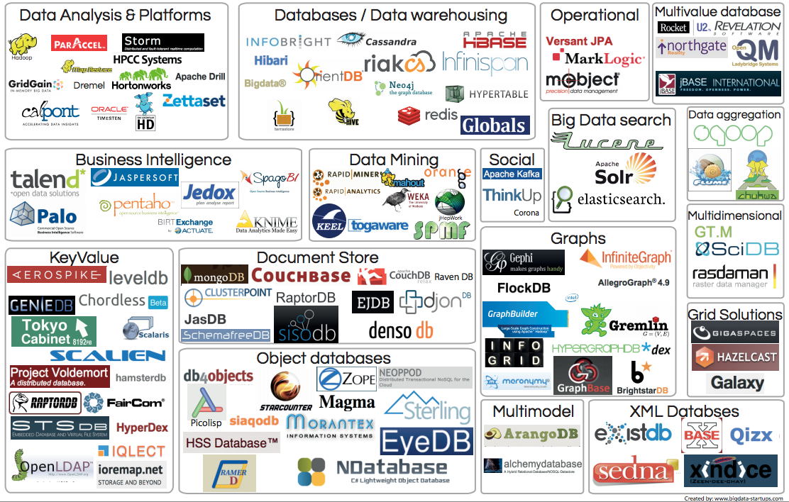
What is Big Data – Still Deciding

Slide 9
Data Structure
All data has structure. There is no such thing as unstructured data (Except for completely random bits).
There are two kinds of structure:
The File
The Data in the file
Structured Data:
CSV, TSV, JSON, XML, Web Forms, Message Protocols
Semi Structured Data:
Images, audio, Free Text

Slide 10
Data Structure
 | File | Data
Structured | Almost all file types | CSV, TSV JSON, XML Web Forms Message Protocols SPI, I2C, HL7
Semi-Structured | Text File | Binary Data: Images, audio Free Text

Slide 11
The Five Vs
Volume
Variety
Velocity
Viscosity
Veracity

Slide 12


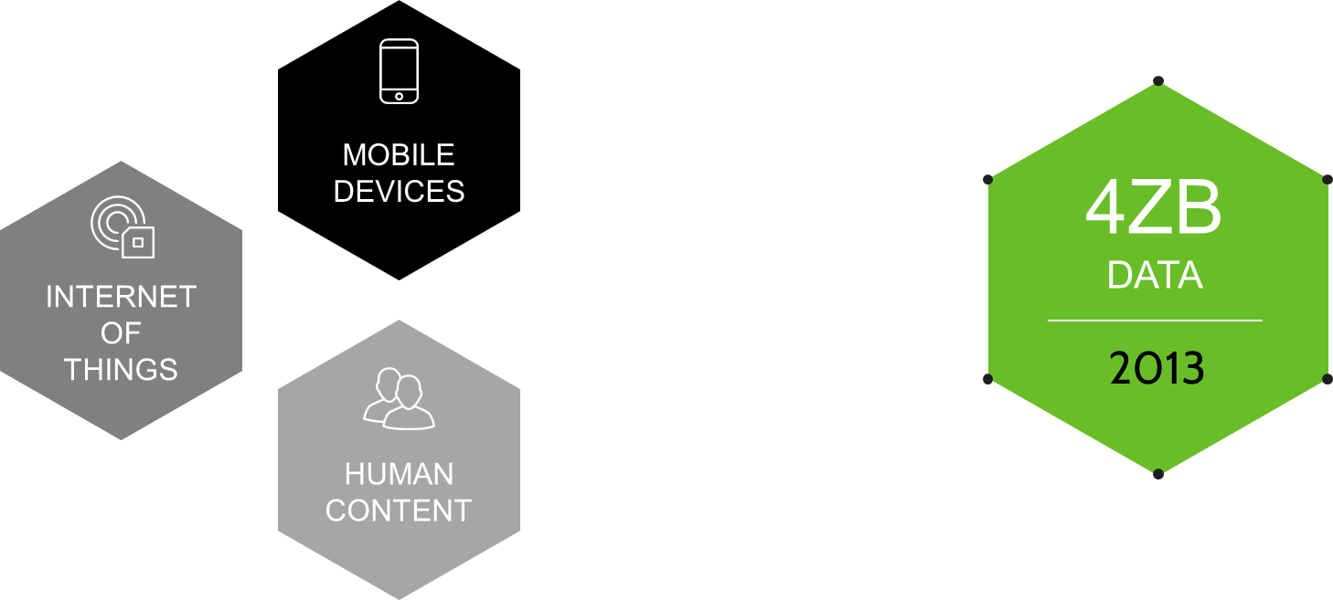
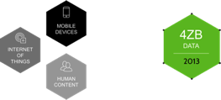

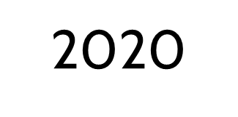
MOBILE DEVICES
44ZB
DATA
4ZB
DATA
INTERNET OF THINGS
HUMAN CONTENT

Slide 13
The Five Vs – Volume
The quantity of generated data is important in this context. The size of the data determines the value and potential of the data under consideration, and whether it can actually be considered big data or not. The name ‘big data’ itself contains a term related to size, and hence the characteristic.

Slide 14
The Five Vs – Variety
The type of content, and an essential fact that data analysts must know. This helps people who are associated with and analyze the data to effectively use the data to their advantage and thus uphold its importance.

Slide 15
The Five Vs – Velocity
In this context, the speed at which the data is generated and processed to meet the demands and the challenges that lie in the path of growth and development.

Slide 16
The Five Vs – Veracity
The quality of captured data, which can vary greatly. Accurate analysis depends on the veracity of source data.

Slide 17
The Five Vs – Viscosity
The timeliness and relevance of data in regards to to our analysis and decision making. Also refers to the requirement to retain the data due to organizational or regulatory needs.

Slide 18
The Five Vs – Viscosity
The timeliness and relevance of data in regards to to our analysis and decision making. Also refers to the requirement to retain the data due to organizational or regulatory needs.

Slide 19
Big Data History
1880 – Census took 8 years to tabulate.
1881 – Hollerith Tabulating Machine developed to tabulate Census. Led to the start of IBM
1941 – Term “Information Explosion” coined
1944 – Estimated that American University libraries are doubling their content every 16 years.
1948 – Information Theory founded by Claude Shannon
1966 – Centralized Computing enters the mainstream
1970 – Edgar Codd develops the Relational Database
Notes:
Reference: http://www.winshuttle.com/big-data-timeline/

Slide 20
Big Data History
1980 – Parkinsons Law. Data expands to fill the space available . . . because users have no way of identifying obsolete data.
1985 – Advent of the Data Warehouse
1989 – The term Business Intelligence is defined by Howard Dresner.
1992 – The first database reporting tool released; Crystal Reports.
1996 – The Internet goes mainstream.
1996 – The emergence of true BI platforms.
Notes:
Reference: http://www.winshuttle.com/big-data-timeline/

Slide 21
Big Data History
1997 – The term "big data" used for the first time in an article by NASA researchers Michael Cox and David Ellsworth
1997 – Estimated that there are a few thousand petabytes of information in the world
1999 – The term “Internet of Things” is coined by Kevin Ashton of MIT
1999 – First study that quantified, in computer storage terms is completed and estimated at 1.5 Exabytes.
2001 – First appearance of the THREE Vs in a Gartner report.
Notes:
Reference: http://www.winshuttle.com/big-data-timeline/

Slide 22
Big Data History
2002 – Development of Web Services contributes to easy information access online.
2003 – Google File System paper published.
2004 – Google MapReduce paper published
2005 – Tim O’Reilly coins the term ‘Web 2.0’.
2006 – Hadoop is created
2007 – IDC estimates that in 2006 alone, 161 exabytes of data was created world-wide
2008 – Bret Swanson and George Gilder projected that U.S. IP traffic could reach one zettabyte by 2015
Notes:
Reference: http://www.winshuttle.com/big-data-timeline/

Slide 23
Big Data History
2008 – Paper ‘Big Data Computing: Creating Revolutionary Breakthroughs in Commerce, Science, and Society’ is published endorsing the credibility of Big Data.
2009 – Estimated that in 2008, the world’s servers processed 9.57 Zettabytes of information
2009 – Tim Berners-Lee coins the term "linked data” which describes a set of best practices for using the Web to create links between structured data
2009 – The world’s servers processed 9.57 Zettabytes of information
Notes:
Reference: http://www.winshuttle.com/big-data-timeline/

Slide 24
Big Data History
There is no definitive history of Big Data.
But there is a history of Hadoop.
Created in by Doug Cutting and other Engineers at Yahoo as a distributed platform for Nutch (a web search engine also written by Doug Cutting) in 2006
Based on the Google File System (GFS) and the Google MapReduce Paper published in 2003
Donated to Apache in 2008

Slide 25
Homework
Read Big Data: The Management Revolution, Harvard Business Review Online. https://hbr.org/2012/10/big-data-the-management-revolution/ar
Get a Google Drive account setup.
Sign up for Amazon Web Services (AWS). http://aws.amazon.com/
Download the Hortonworks Sandbox HDP2.3. Its stupid big like 6GB big so give it time. http://hortonworks.com/products/hortonworks-sandbox/#install

Slide 26
Additional Sources
Jeffrey Dean, Sanjay Ghemawat (2004) MapReduce: Simplified Data Processing on Large Clusters
http://research.google.com/archive/gfs-sosp2003.pdf
Fay Chang et al. (2006) Bigtable: A Distributed Storage System for Structured Data
http://hadoop.apache.org
Chapter 1 – White, Tom. (2012) Hadoop: The Definitive Guide. O’Reilly Media
Bryant, Randle, et al. "Big-Data Computing: Creating revolutionary breakthroughs in commerce, science, and society" http://cra.org/ccc/wp-content/uploads/sites/2/2015/05/Big_Data.pdf
Boyda, Danah and Crawford, Kate. "Critical Questions for Big Data". http://www.tandfonline.com/doi/full/10.1080/1369118X.2012.678878#abstract

